Slide 1
The COSMOS Strong Motion Forum
15th World Conference on Earthquake Engineering
September 25th, 2012
Lisbon, Portugal
BOGAZICI UNIVERSITY,
KANDILLI OBSERVATORY AND EARTHQUAKE RESEARCH INSTITUTE (KOERI)
STRONG MOTION NETWORKS
Can Zülfikar
can.zulfikar@boun.edu.tr

Slide 2
The COSMOS Strong Motion Forum
15th World Conference on Earthquake Engineering
September 25th, 2012
Lisbon, Portugal
The Strong Motion Networks managed by KOERI:
Istanbul Earthquake Early Warning System (IEEWS),
Istanbul Earthquake Rapid Response System (IERRS),
Marmara Sea Bottom Observatory System,
KOERI Strong Motion Network,
Istanbul Natural Gas Distribution Co. (IGDAS) Strong Motion Network,
KOERI Structural Health Monitoring Networks,

Slide 3
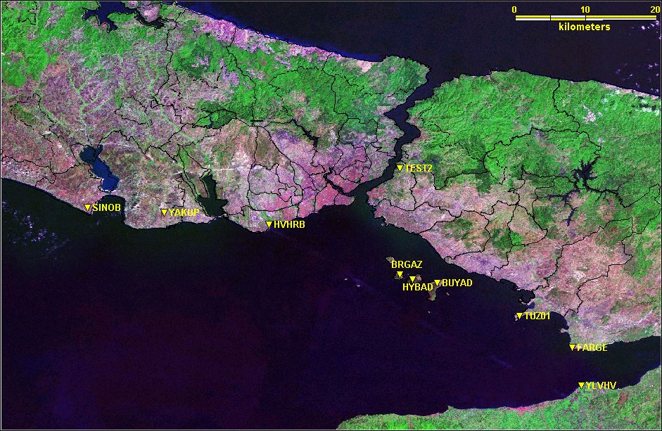
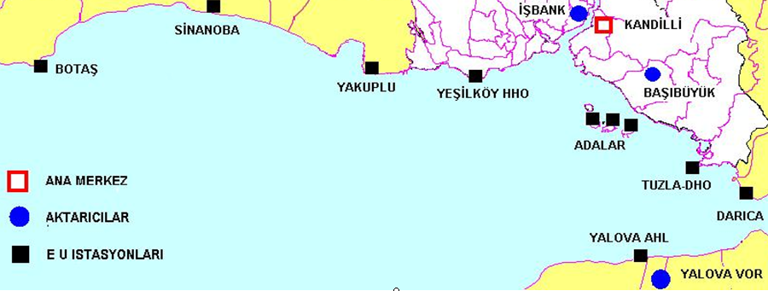
ISTANBUL EARTHQUAKE EARLY WARNING SYSTEM
The Early Warning part of the I-NET 10+2 strong motion stations were located as close as possible to the Great Marmara Fault zone in “on-line” mode.
Data Transmission is provided with Satellite.
The continuous on-line data from these stations is used to provide real time warning for emerging potentially disastrous earthquakes.
Notes:
3

Slide 5
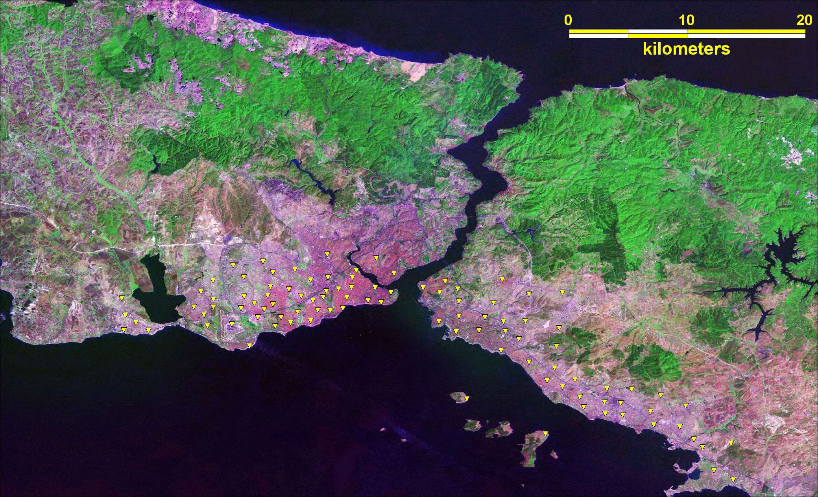
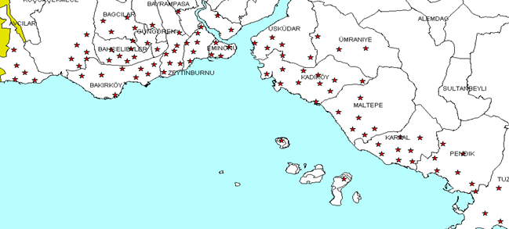
ISTANBUL EARTHQUAKE RAPID RESPONSE SYSTEM STATIONS
100 SM stations
in triggering mode,
SHAKE- and LOSS-MAPS

Slide 6
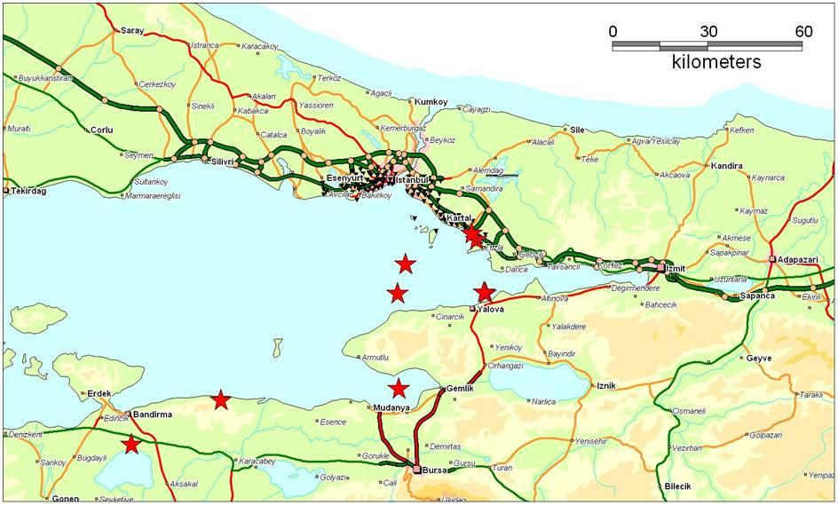
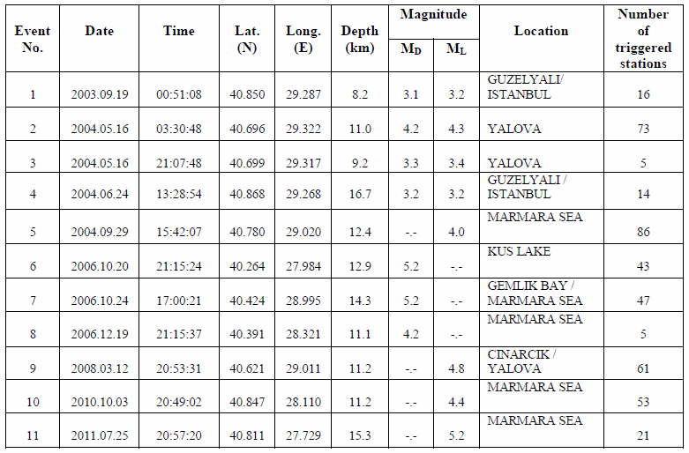
Location of earthquakes recorded by the system
Information on recorded Earthquakes
Notes:
6

Slide 7
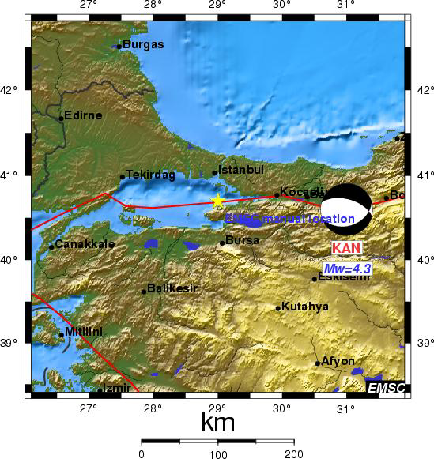
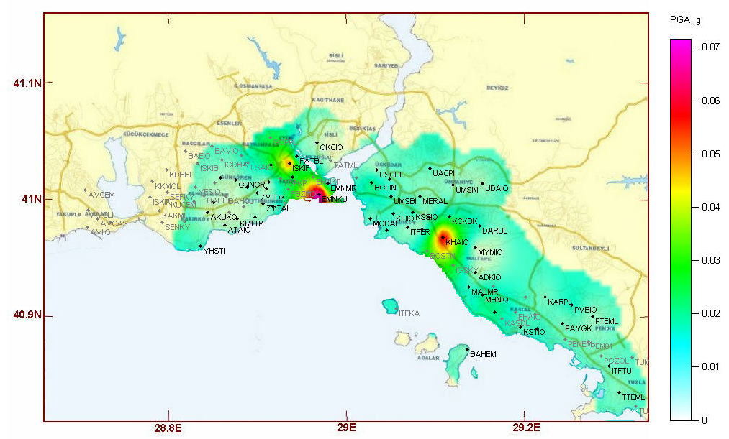
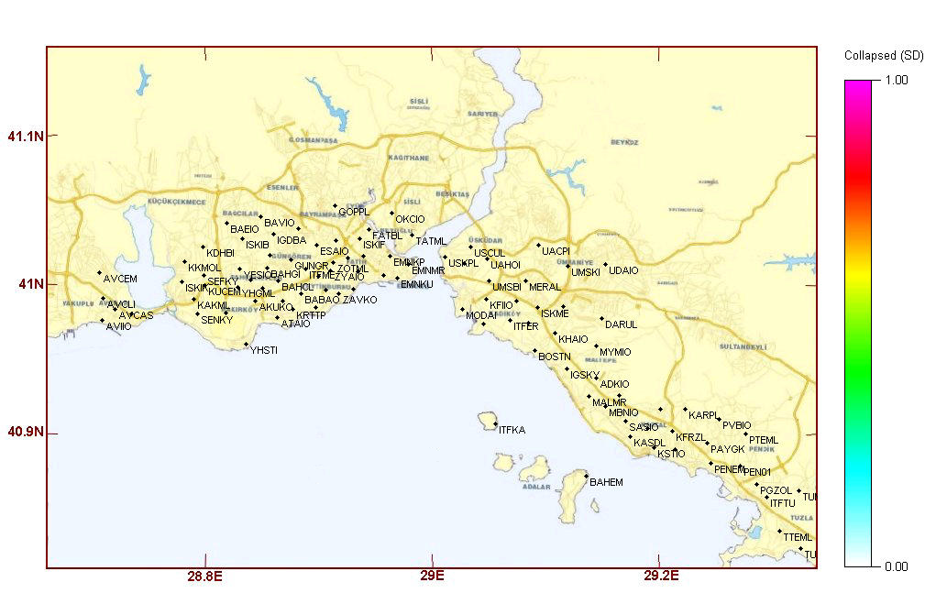
March 12 2008 Earthquake
Shake and Loss Map
Notes:
7

Slide 8
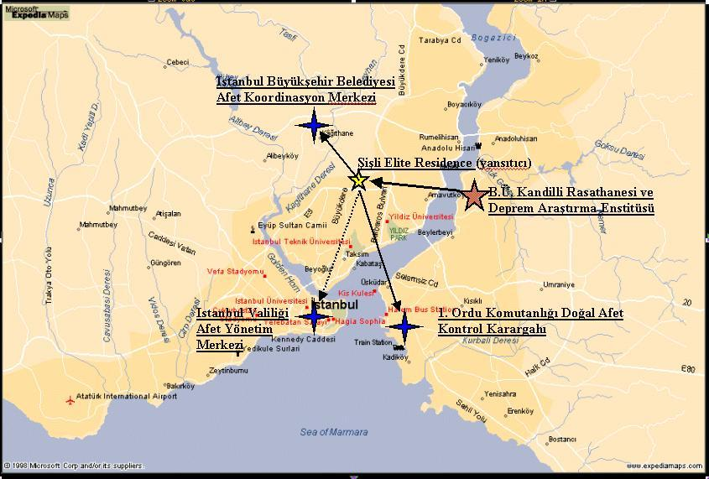
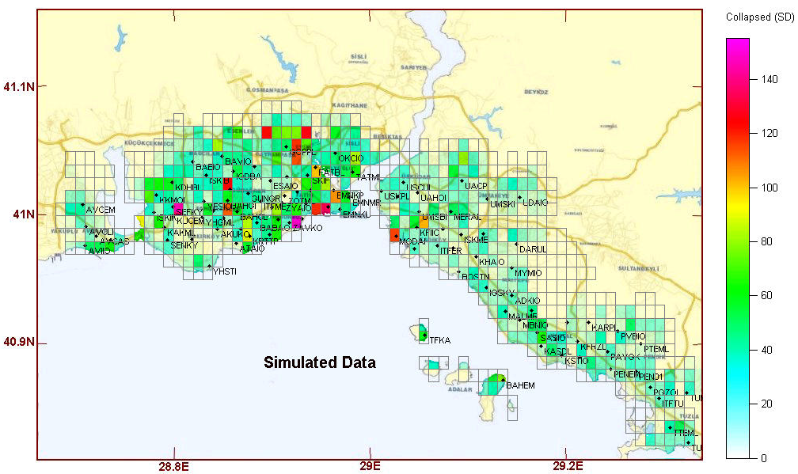
Municipality
Communication of Rapid Response Message (Damage Maps)
(Mobile phones and PDA’s)
Governorate
1st Army
NUMBER OF COLLAPSED BUILDINGS PER CELL (Simulated from random data and communicated to end users every day at 10am)

Slide 9
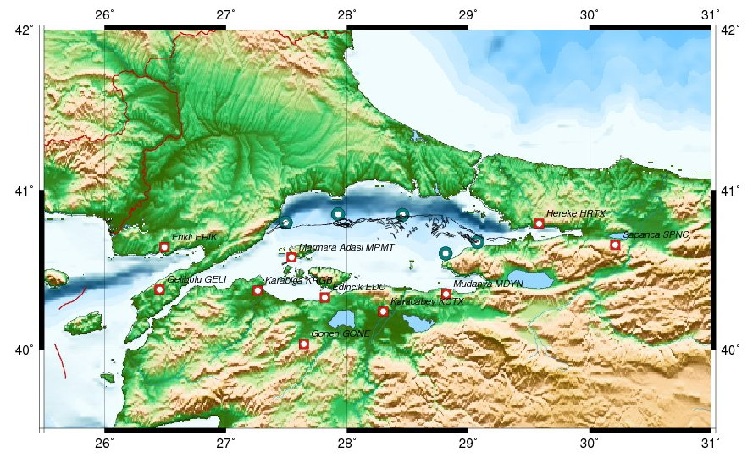
Marmara Sea Bottom Observatory System
Installed in 2011.
5TD 3C Guralp Accelerometers, 3TD 3C Guralp BB seismometers,
Pressure difference measurement, Hydrophene measurement
Temperature measurement, Flow meter, real time camera,

Slide 10
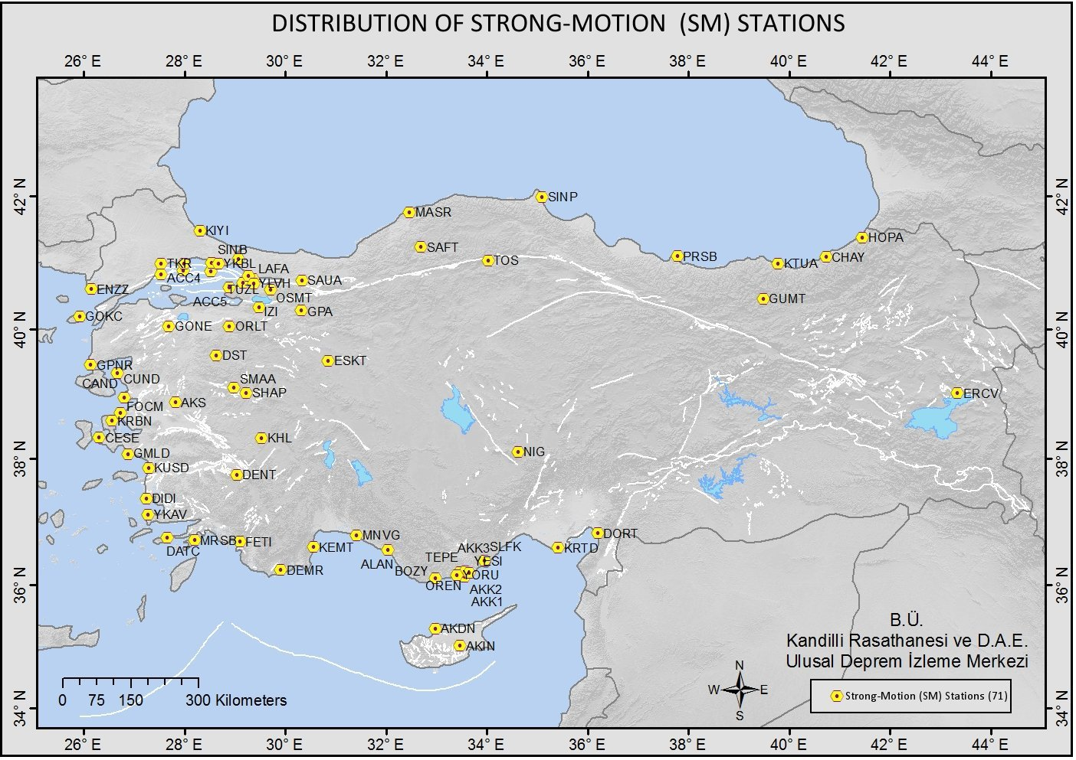
KOERI Strong Motion Network
North-Eastern Atlantic and Mediterranean Tsunami Information Centre

Slide 11
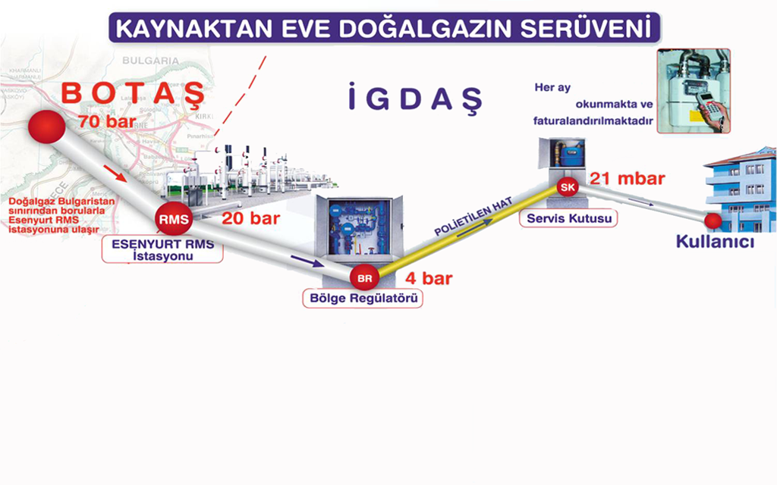
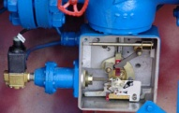
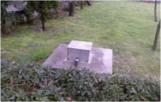
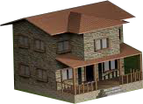

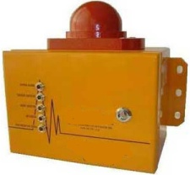
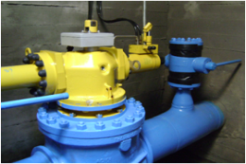

IGDAS
Strong Motion Network
NATURAL GAS FROM SOURCE TO HOME
1400 Solenoid Valves
3.130.281 Counter
SI Sensor
626.564 Service Boxes
USER
Total 11 RMS Station Capacity is 4.000.000 m³/s
693 Regulators
Total 672 Customer Regulators
16.022 PE Valves
Building Shut-Off Valve
Total
13.000 Km PE Line
63 - 110 - 125
487 Valve Rooms 93 Valves with actuator 1706 Steel Valves
4.335.388 Customer
Total
1383 Km Steel Line
4”-6”-8”-12”-16”-20”-24”-28”-30”
4.017.926 Gas User
13

Slide 12
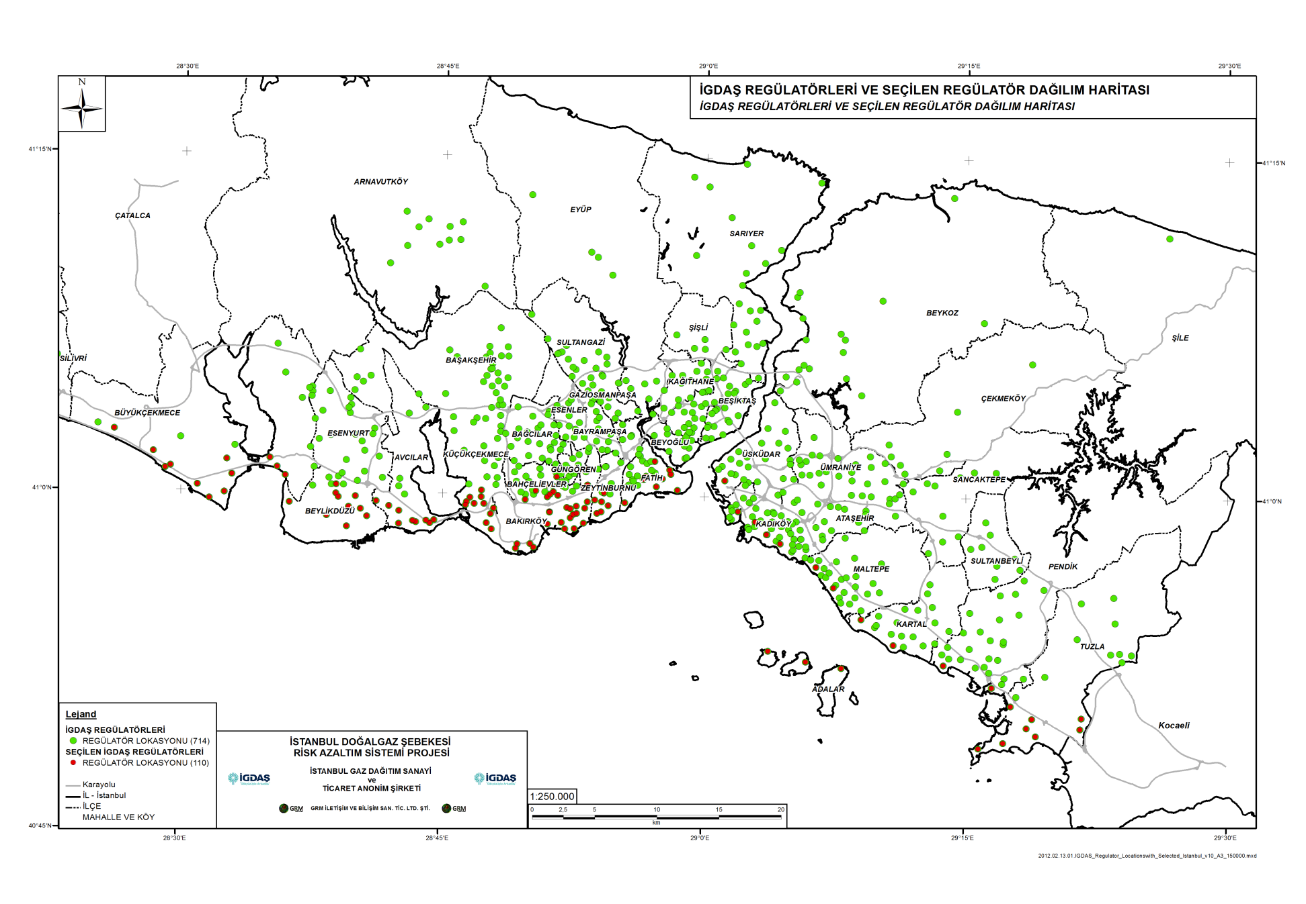
Locations of IGDAS Regulators with SM recorders (red color)

Slide 13
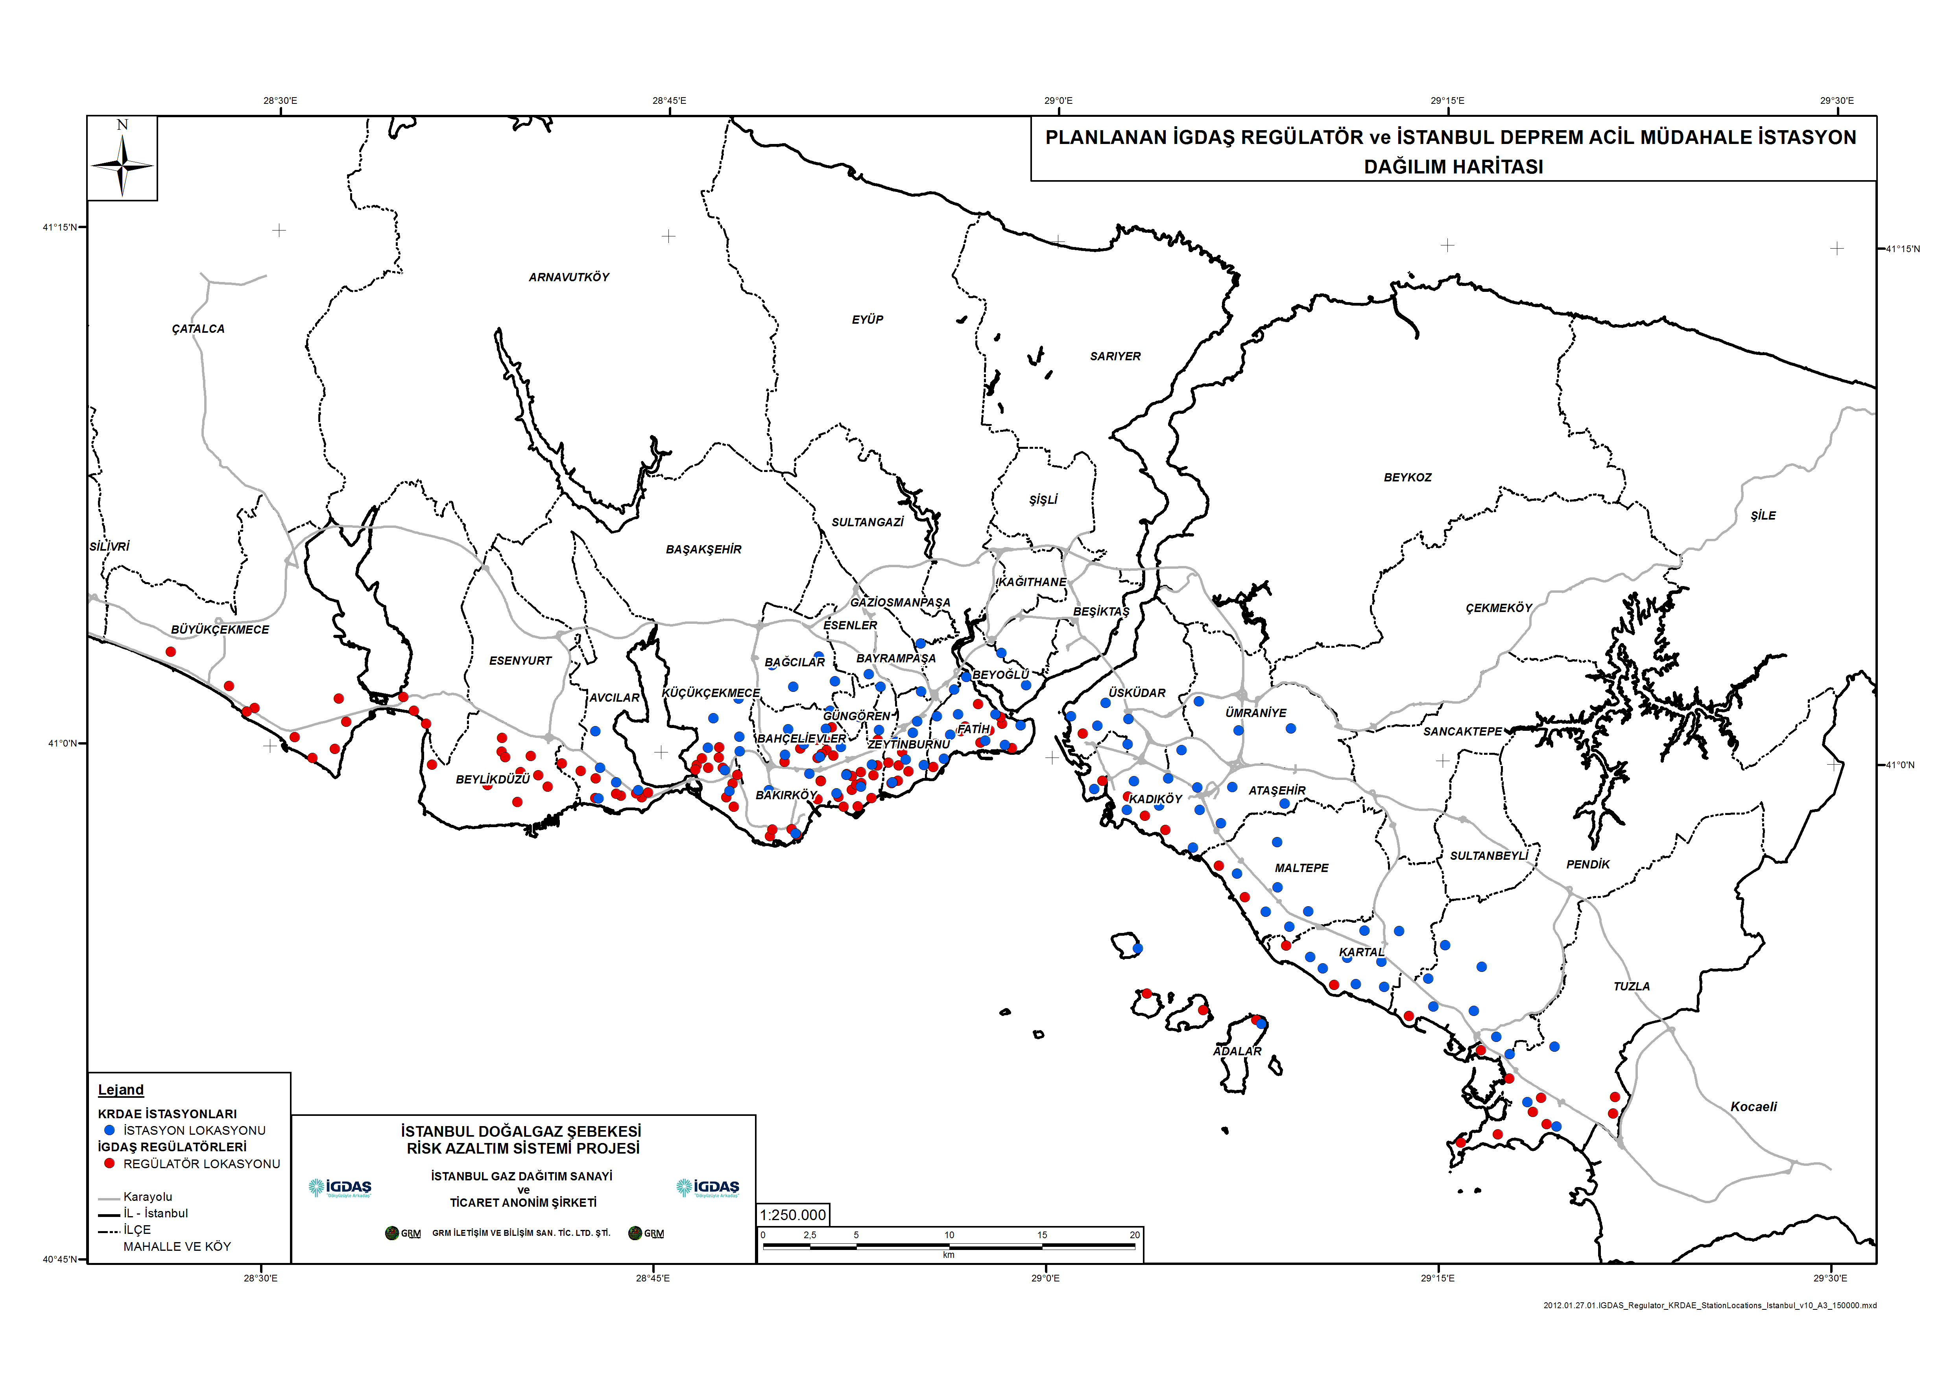
Locations of IGDAS Regulators with SM recorders (red color) and KOERI-IERRS stations (blue color)

Slide 14
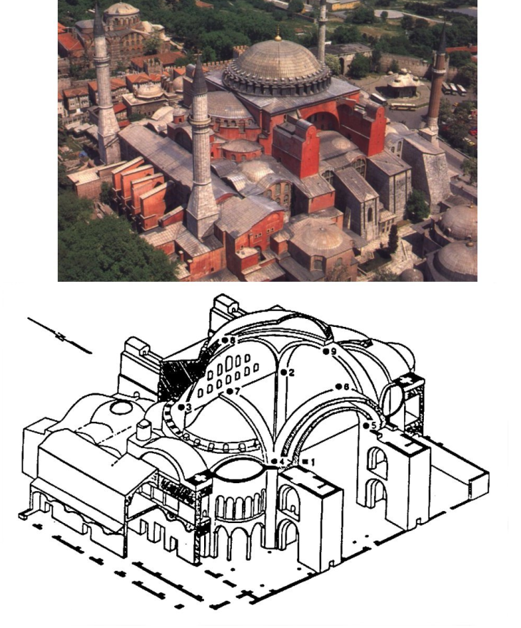
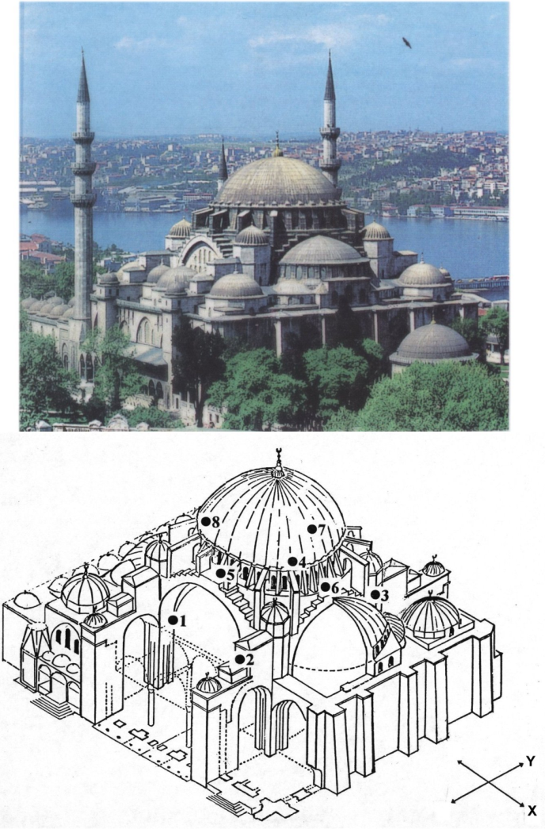
Structural Health Monitoring Networks
Hagia Sophia
Suleymaniye
Fatih
Mihrimah
Tube Tunnel

Slide 15
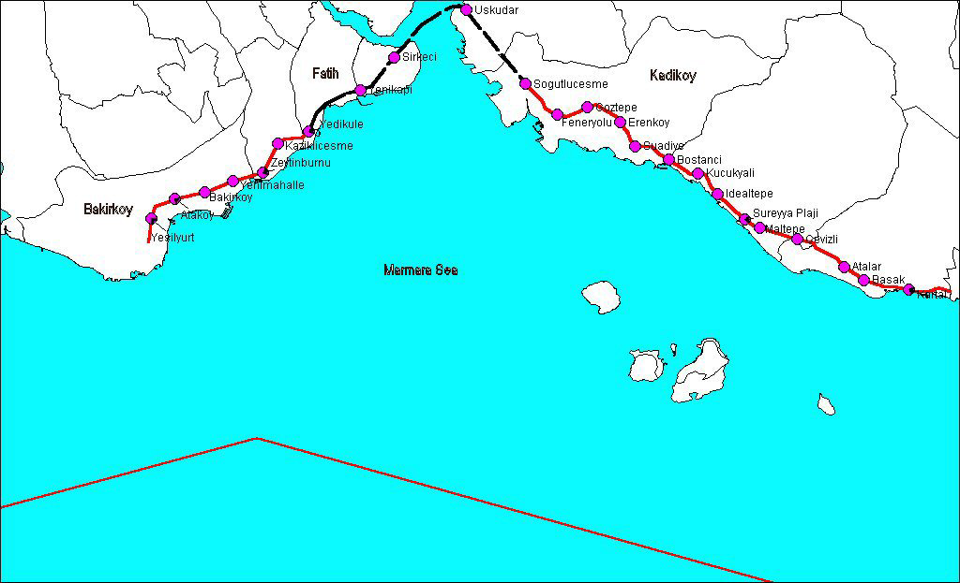
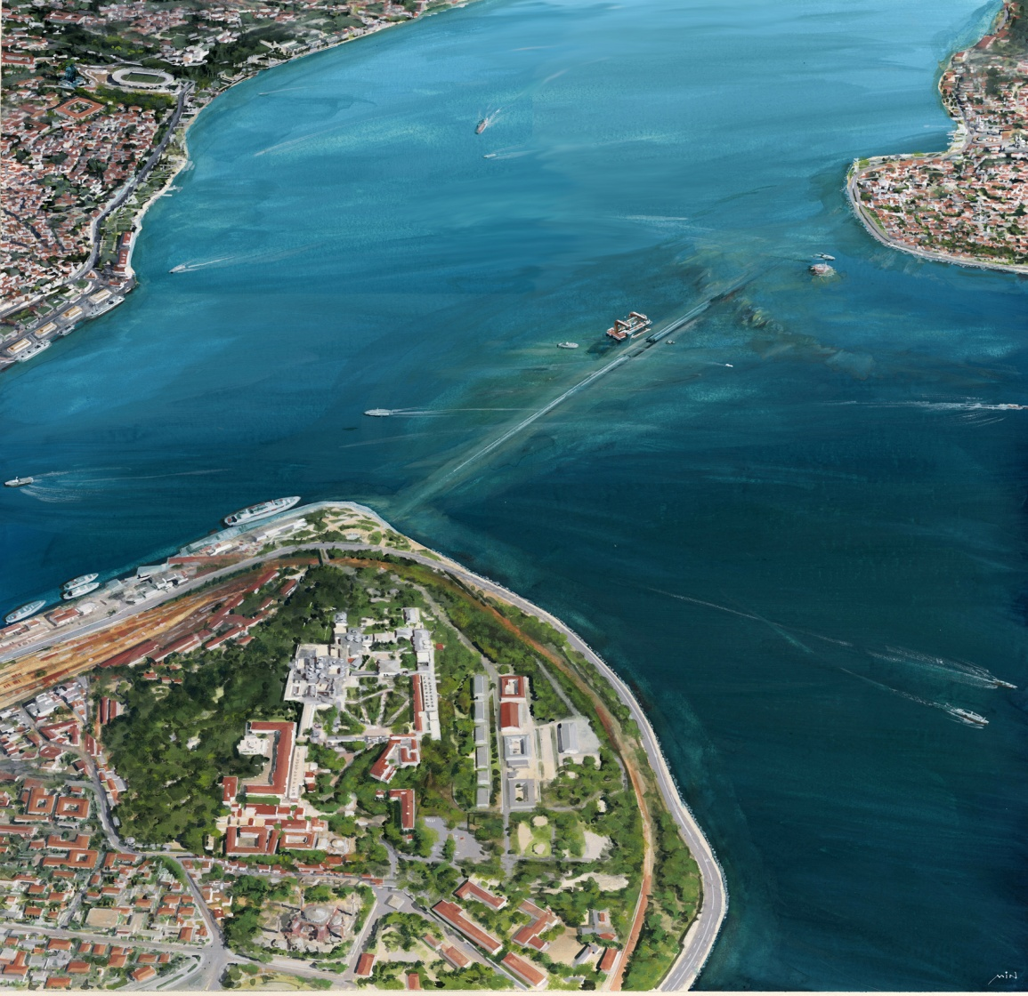
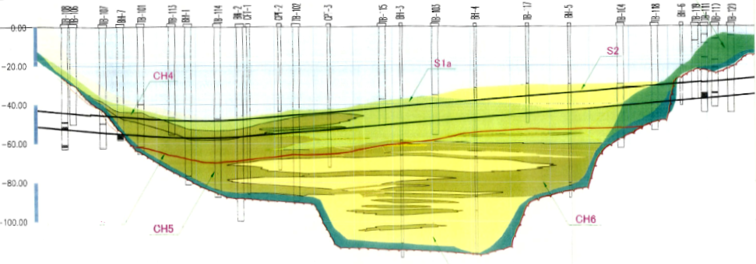
EEW
FAST TRAIN AND TUBE TUNNEL
Notes:
15

Slide 16
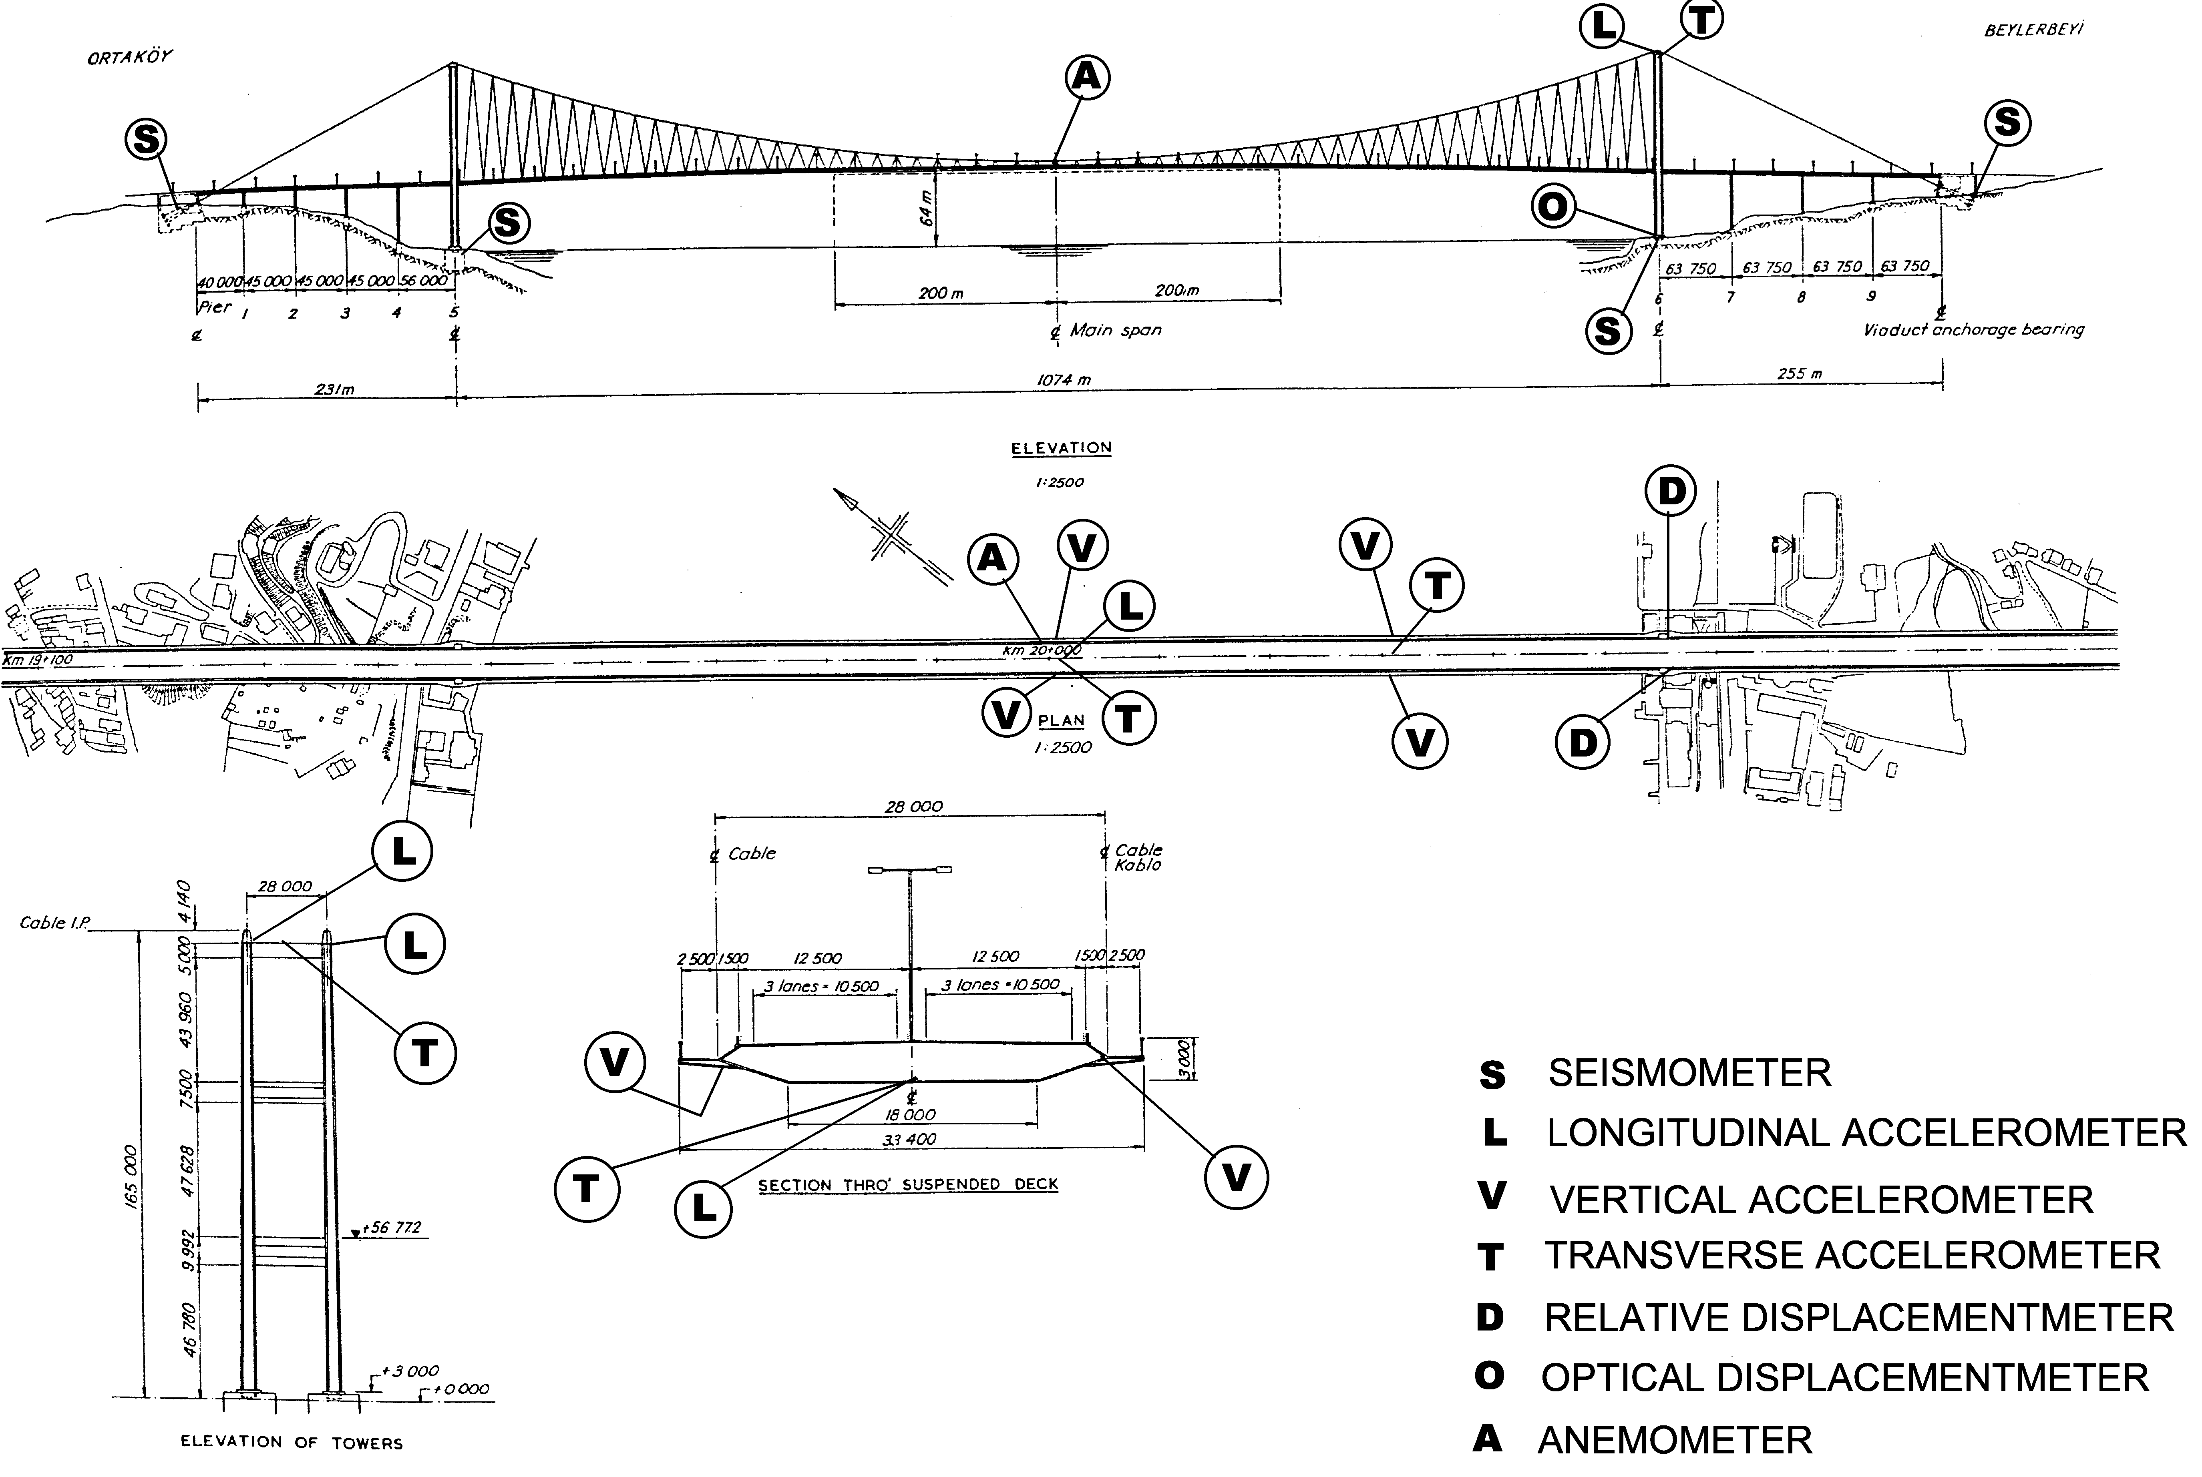
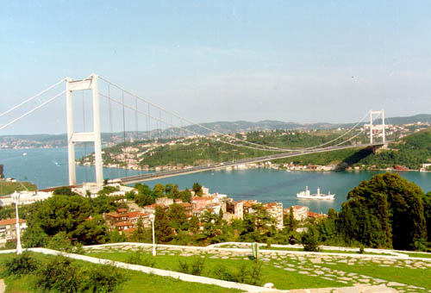
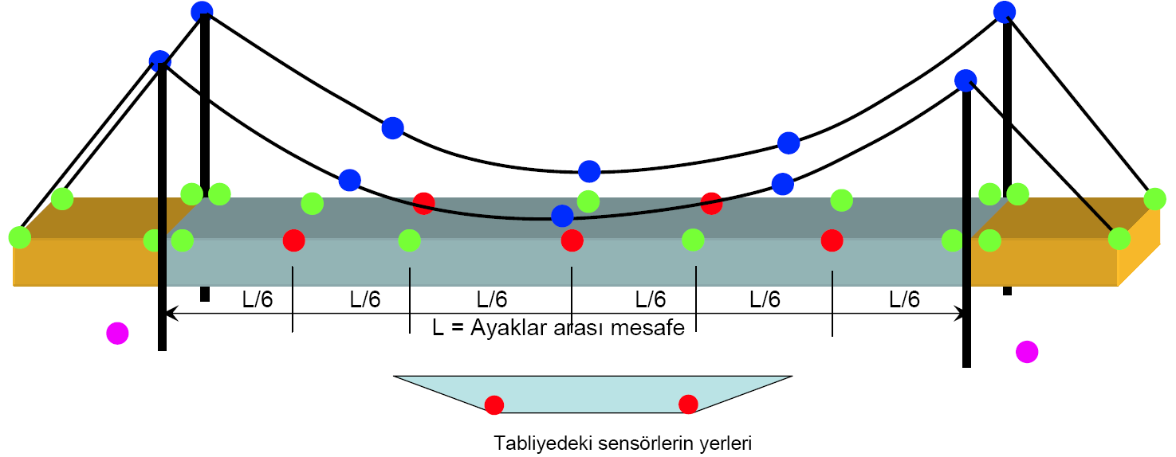
Structural Health Monitoring
BOĞAZİÇİ BRIDGE
FATIH BRIDGE

Slide 17
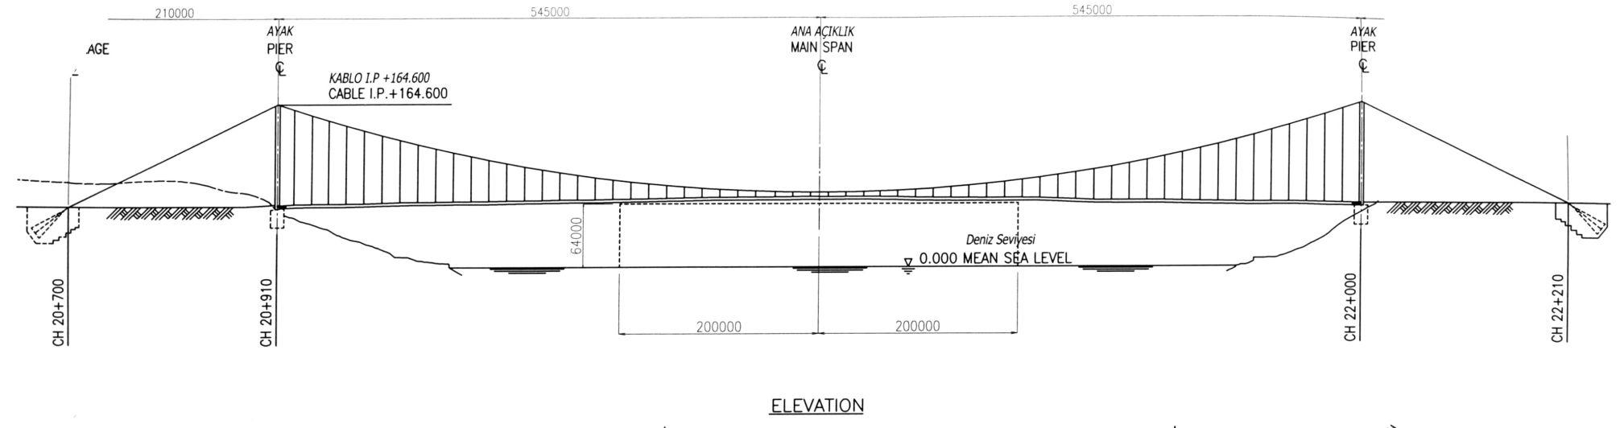
FATIH BRIDGE

Slide 18
FACILITY SPECIFIC EEW SYSTEMS
Notes:
18

Slide 19
THANK YOU

