Slide 1

ITALIAN STRONG MOTION DATA ARCHIVING AND DISTRIBUTION
INGV Strong Motion working group
L. Luzi, R. Puglia, E. Russo, F. Pacor, M. Massa,
P. Augliera, S.Lovati and G. Franceschina
Istituto Nazionale di Geofisica e Vulcanologia (INGV)
Milano, Italy

Slide 2
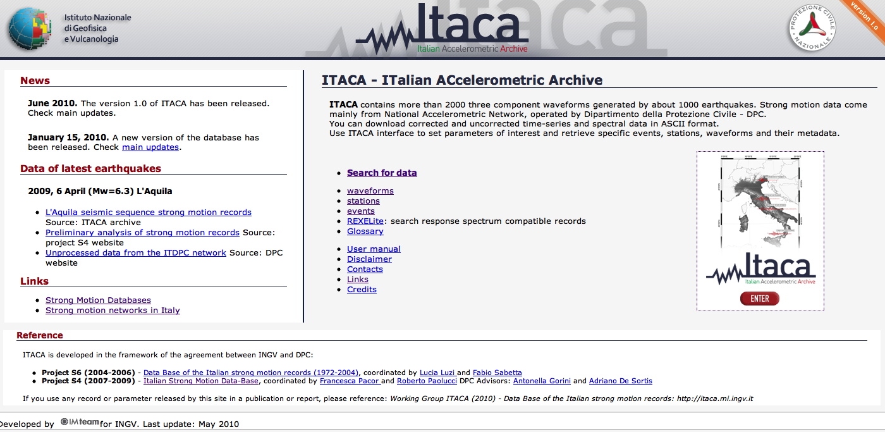
ITACA http://itaca.mi.ingv.it
ITACA is an infrastructure conceived to collect, organize, publish and browse strong-motion data mainly coming from the Italian DPC seismic network. Actually the database is frozen and contains Italian data from 1972 to 2009 (L’Aquila sequence). The update and future developments depend on the agreement between INGV and DPC

Slide 3
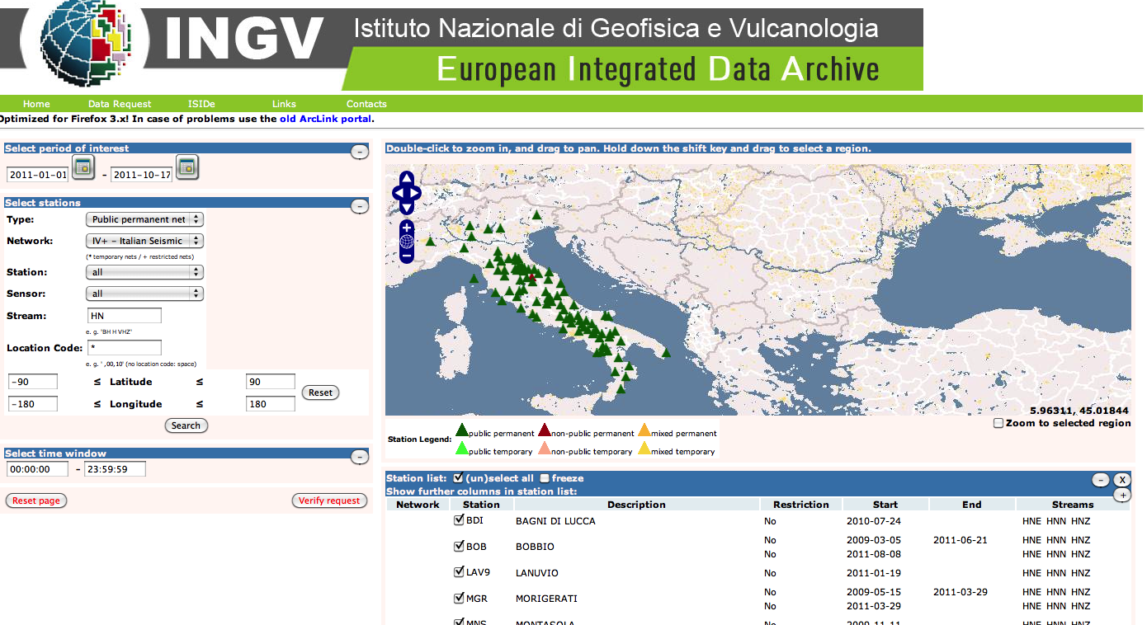
Recent developments
In the framework of the European projects NERIES (closed in 2011) and NERA, a distributed European archive (EIDA) of continuous digital waveform from high quality seismometer stations in and around Europe has been created. SM data from various institutions (INGV, GFZ, ETH, ORFEUS) can be directly accessed

Slide 4
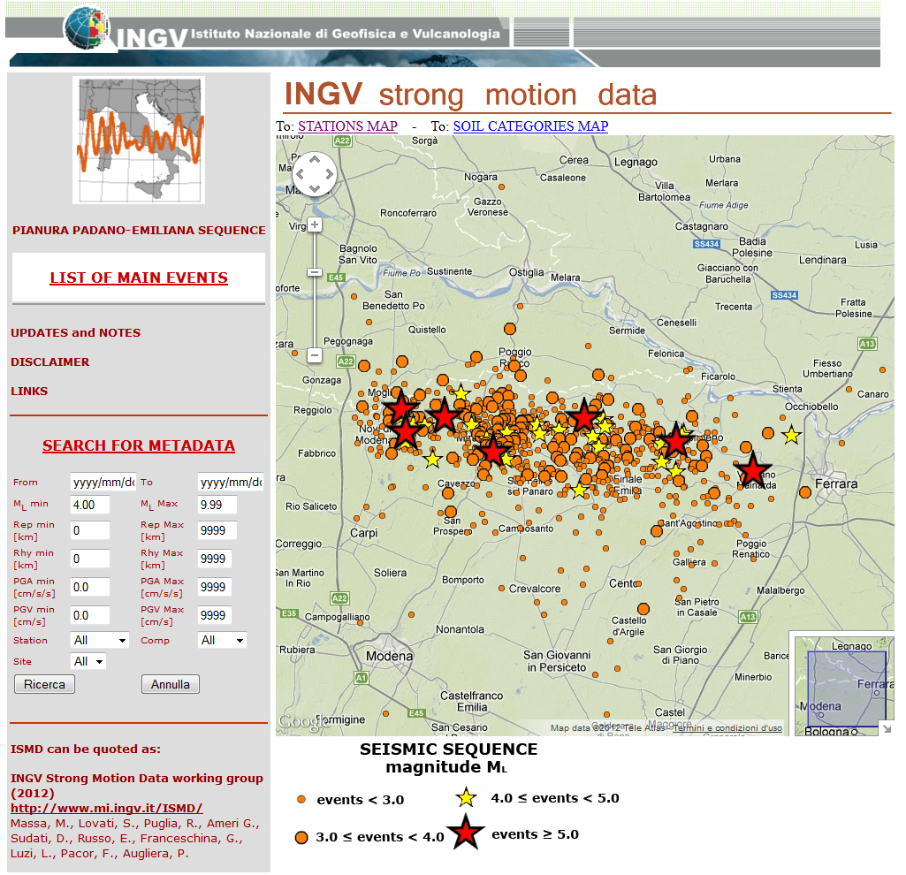
NEW INGV SM web-portal
1) ISMD is an archive for real-time analysis
Through a semiautomatic procedure INGV SM data from the EIDA system are downloaded and archieved.
The data, in ASCII format, are stored for event. The related SM parameters are obtained from automatic processing.
Raw SM data and related metadata can be downloaded by the user in quasi-real time after an event.
http://www.mi.ingv.it/ISMD/ismd.html

Slide 5
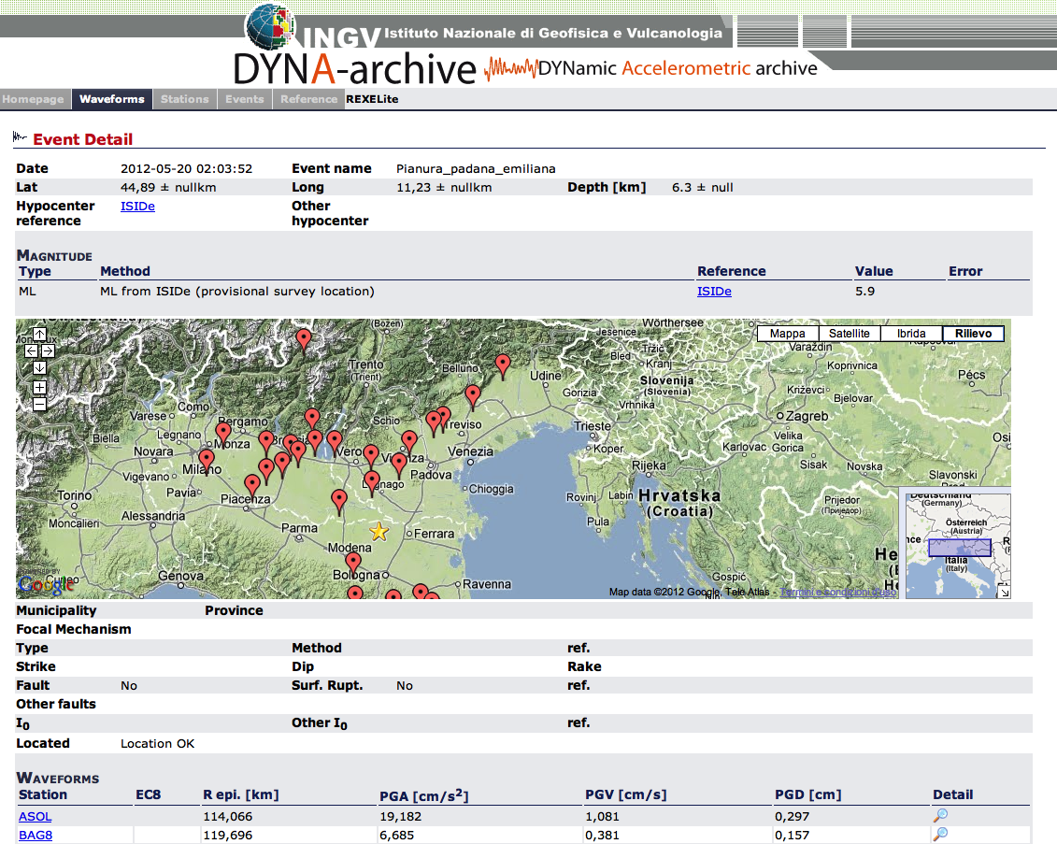
New SM Database of INGV data
2) DYNA-Archive is a relational database, containing INGV processed waveforms and related metadata.
Its compilation is semi-automatic:
After an EQ alert, an automatic procedure starts to download SM data from EIDA and store event and station metadata in the database which grows automatically.
Manual interaction is required for data processing and introduction of additional and updated metadata (Mw, focal mechanism, references, Vs30, etc.).
http://dyna.mi.ingv.it/DYNA-archive/

Slide 6
Summary
In Italy 2 National accelerometric networks coexist: one managed by DPC since 1972 and the other by INGV since 2006
The Italian SM database ITACA has been developed after an agreement between DPC and INGV: it contains mainly DPC SM data from 1972 to April 2009. Actually, it is frozen. Its future maintenance is not defined

Slide 7
Summary
The first release of a web portal for distributing INGV SM data has been published, after the 2012 Emilia seismic sequence.
ISMD is an archive, in quasi-real time, of raw waveforms: SM data can be downloaded for the events of the Emilia seismic sequence with M > 4
Dyna-archive is the prototype of INGV SM database and exploits the accessibility of continuous SM data from EIDA: it contains INGV SM data from 2009 to today.
The most relevant feature is the dynamic population. At the moment, the waveforms are not downloadable

