Slide 1
Strong Motion Forum
COSMOS
Sep. 25, 2012, 5:15-7:15pm
Room 1.08, Lisbon Congress Center
Strong Motion Network in Taiwan
Kuo-Liang, Wen
Dept. of Earth Sciences
National Central Univ., Taiwan

Slide 2
Taiwan Strong Motion Instrumentation Program
(TSMIP)
Started from 1990
Installed and maintained by CWB (http://www.cwb.gov.tw )
Strong Motion Station
  More than 809
  110 real-time stations
  57 building arrays
  16-bit and 24-bit

Slide 3
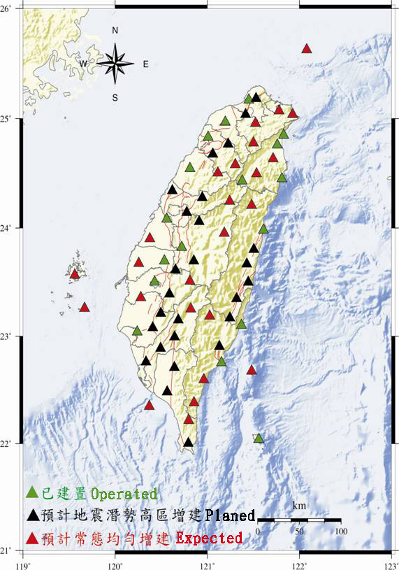
CWB High-quality Downhole Earthquake
Monitoring Network
Down to the depth of 300 m or bedrock
Surface and downhole strong motion seismograph, and downhole broadband seismograph
Improve the quality of seismograms and the accuracy of earthquake locations

Slide 4
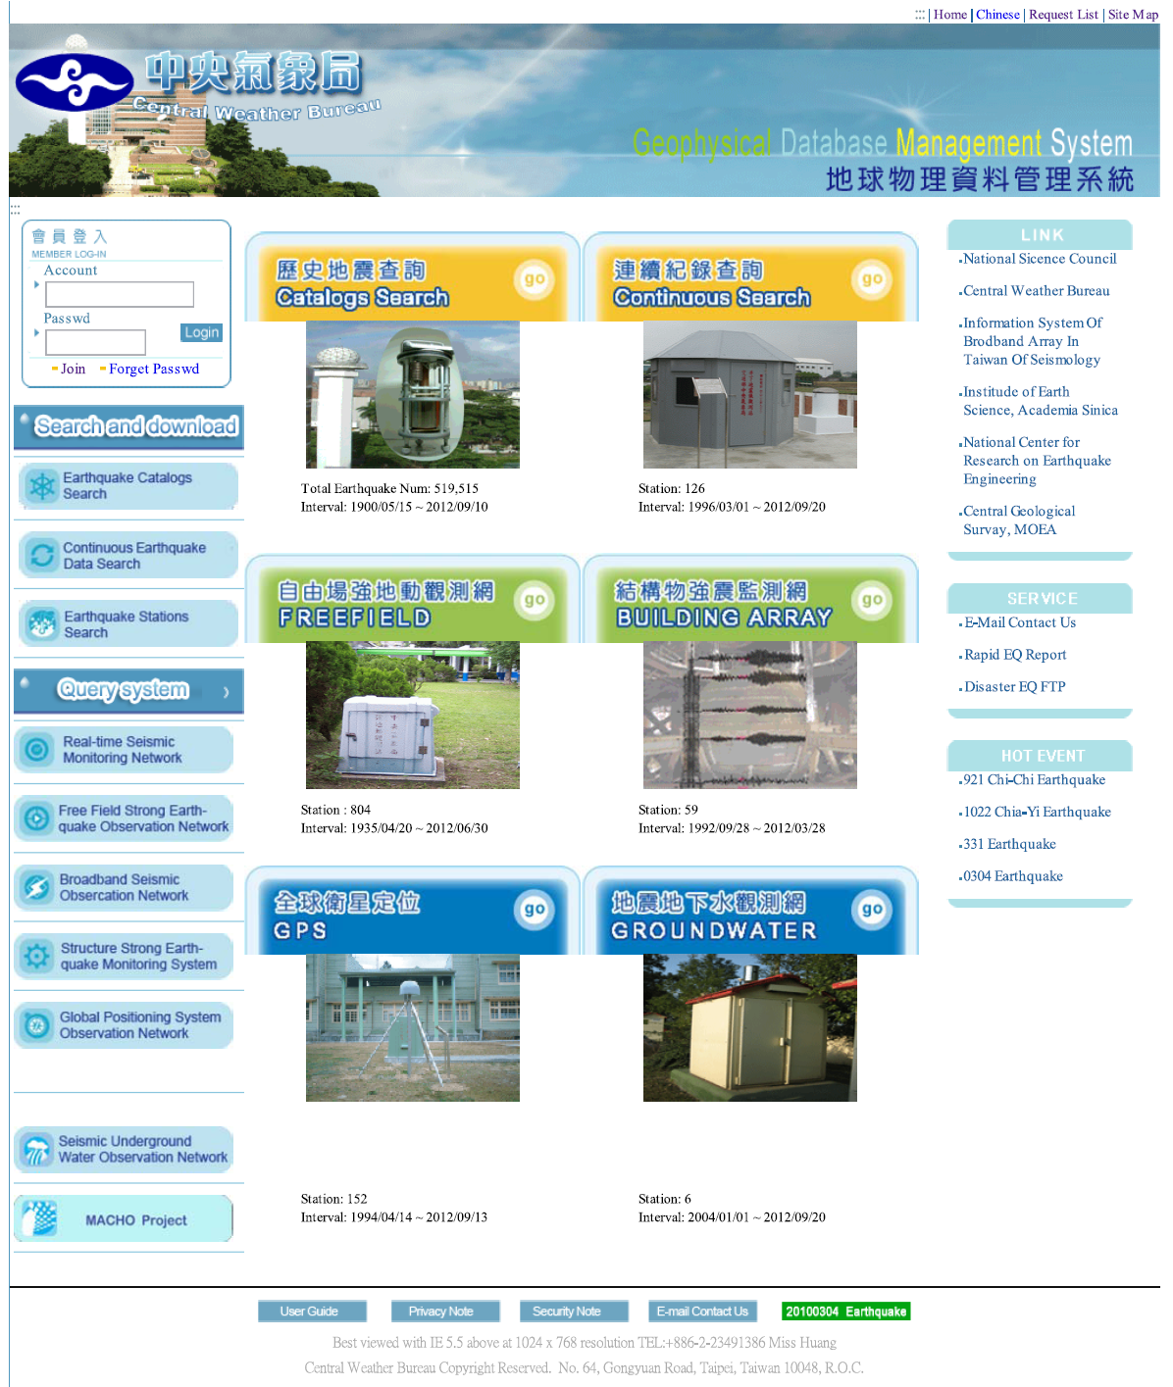
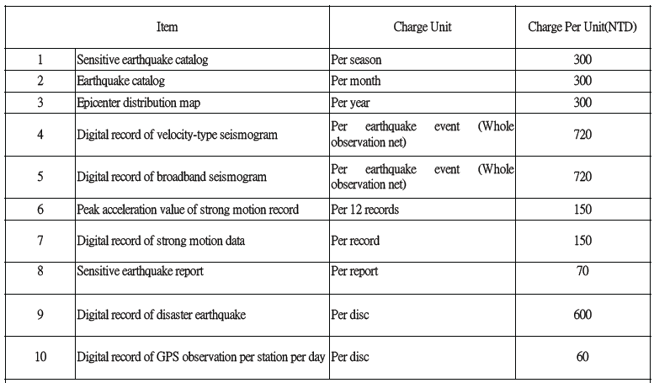
Geophysical Database Management System (GDMS) http://gdms.cwb.gov.tw
GDMS provides CWB various seismic observation data available for principal research fellows of seismic study
But, the register of GDMS is only for Taiwan user now
Anonymous users can download the data of real-time stations only for recent felt earthquakes and the disastrous earthquakes
webqry@cwb.gov.tw

Slide 5
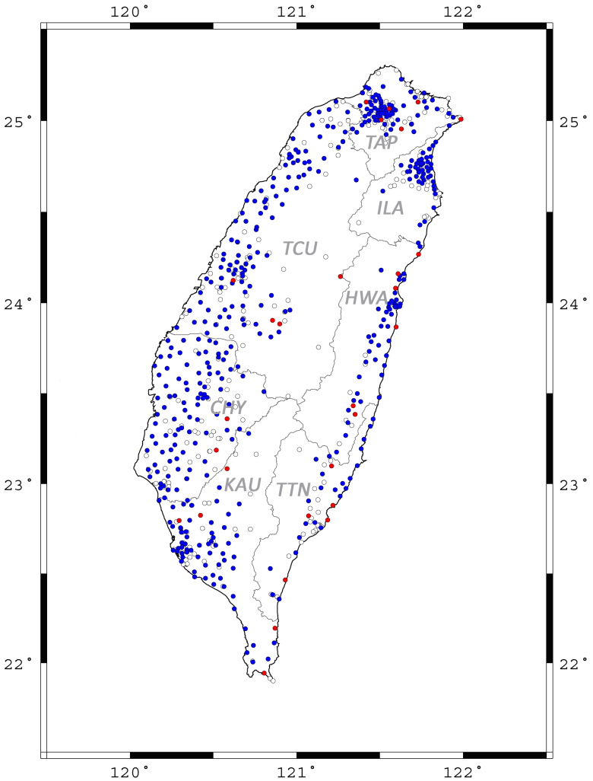
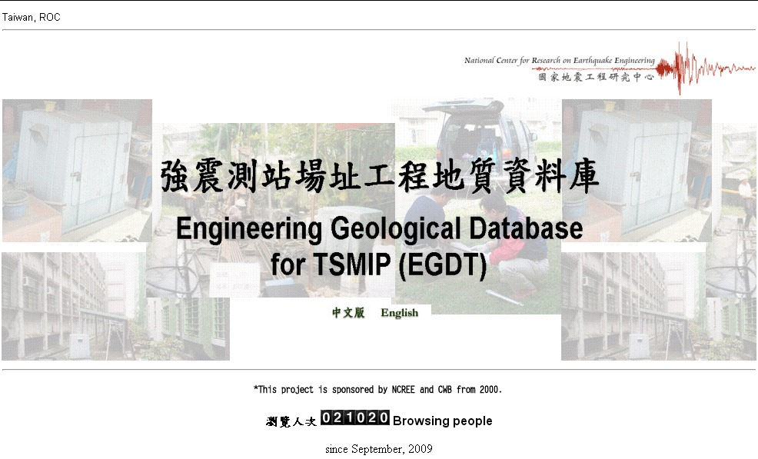
Engineering Geological Database for TSMIP (EGDT, http://egdt.ncree.org.tw )
This project was established by CWB and NCREE since 2000 to collect and provide the subsurface data of TSMIP stations
Site investigations at 447 station sites were completed with depth of at least 35 m

Slide 6
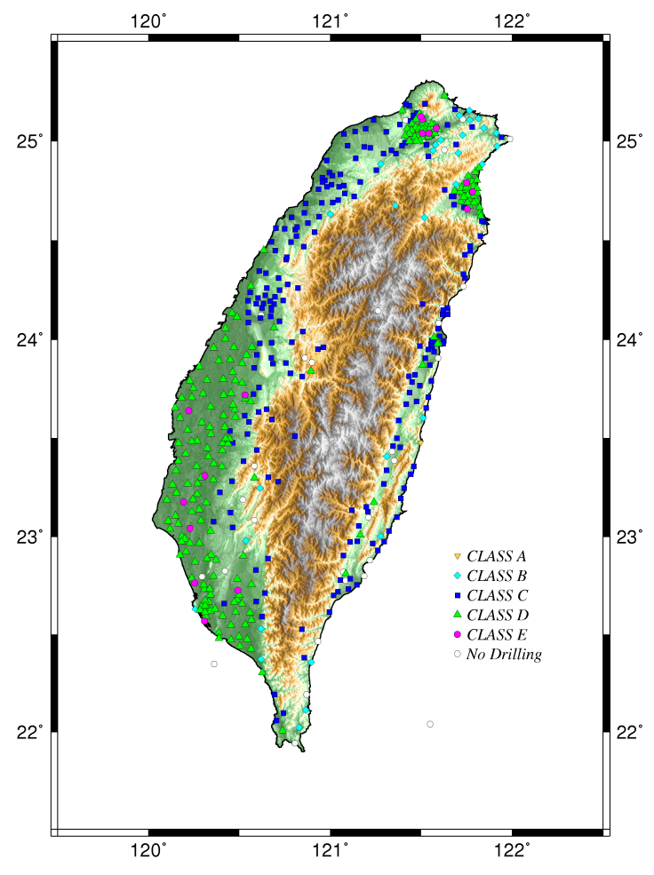
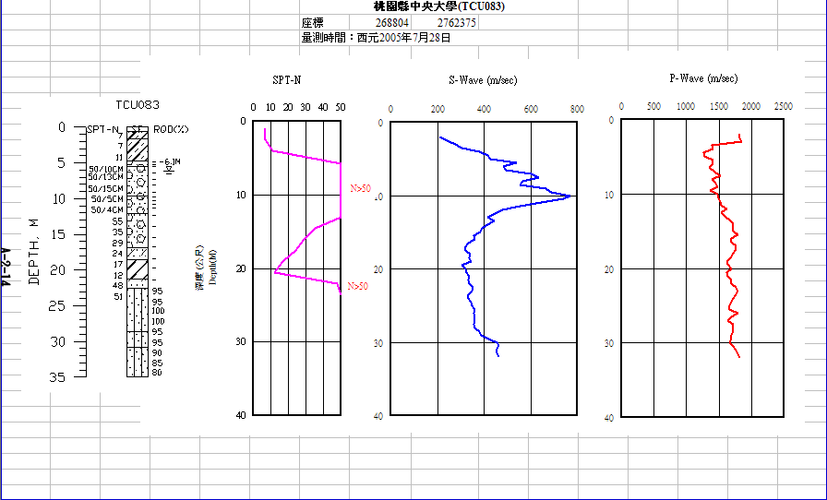
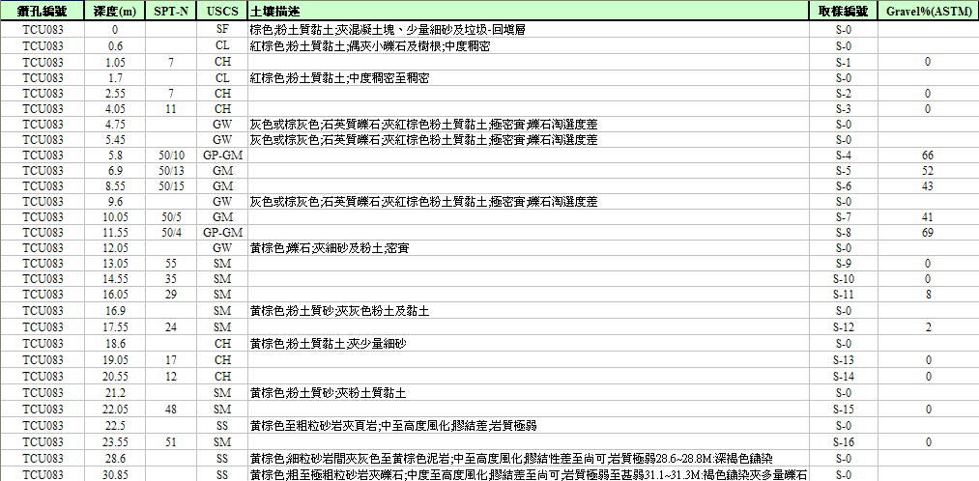
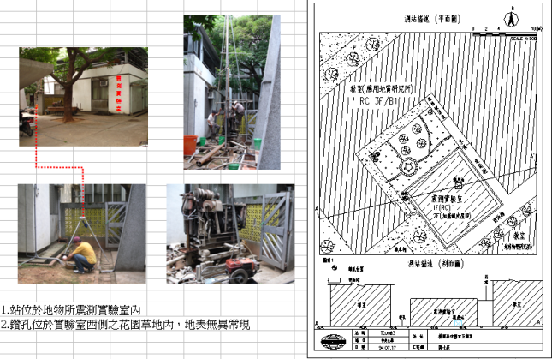
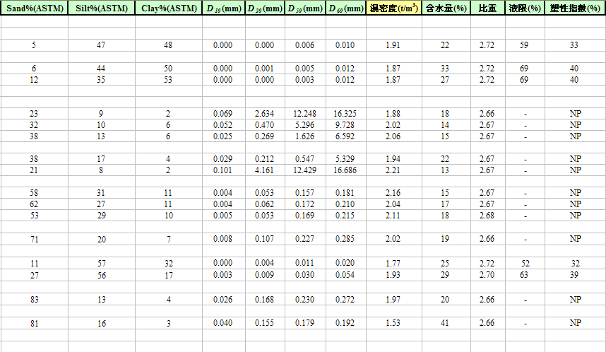
The general information (the photo of the seismograph, the plan section and the cross section of the surrounding environment), the soil profile, the SPT-N value, the shear wave velocity, and the primary wave velocity of the stratum are all available on EGDT website
All the data is open to refer, and the complete digital data can be provided by submitting a requirement
Based on the database, the V_{S}30, site classification, and other site-related researches have been done (Kuo et al., 2011 and 2012)

Slide 7
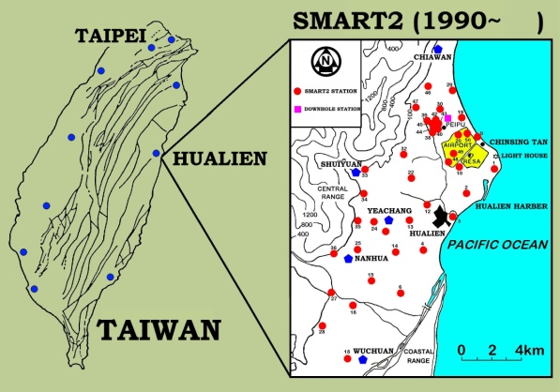
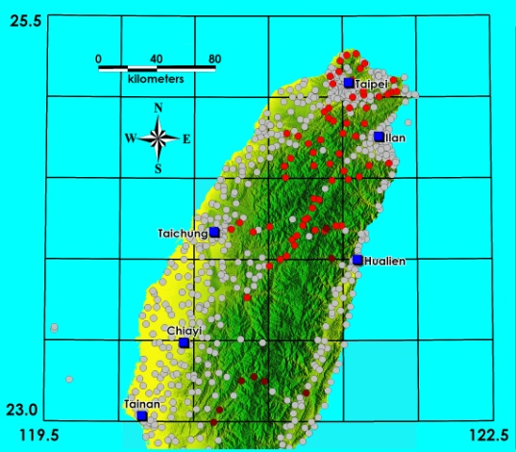
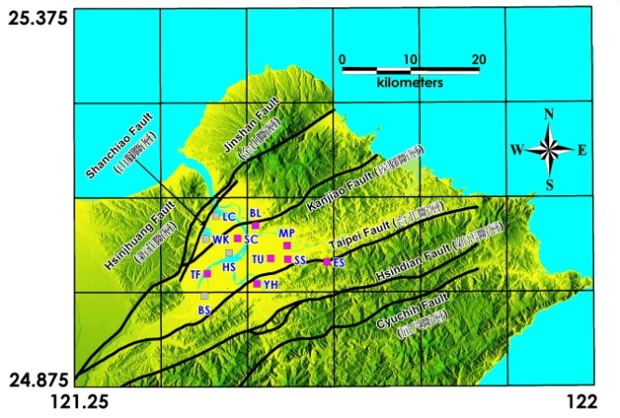
Strong Motion Networks operated by Institute of Earth Sciences, Academia Sinica
Operating Networks
Strong Motion Array in Taiwan, phase II (SMART2)
Seismic Array in the Taiwan Mountain Area (MTN)
Strong Motion Downhole Array in the Taipei Basin
Closed Networks
Strong Motion Accelerographic Network (SMA)
Strong Motion Array in Taiwan, phase I (SMART1)
Lotung Large Scale Seismic Test (LLSST)
Hualien Large Scale Seismic Test (HLSST)
Data Management Center: http://dmc.earth.sinica.edu.tw/
MTN
TPE_DH

